Slide 1
Information Technology Fundamentals
DT228/1
Tutorial 7 – IT Professionals
Thursday 10 November 2016

Slide 2
Information Technology Professionals
JOB TITLES
(Have a look at some here: http://www.ljmu.ac.uk/cmp/95278.htm)
Application Developer
Software Engineer
Front End Developer
Technology Officer
Computer Systems Manager
Database Administrator
IT Support Specialist
Network Engineer
Network Systems Administrator
System Analyst
Web Administrator
Technical Support Engineer
Web Developer
Webmaster
Just a few job titles of many variations

Slide 3
IT Professional
Profession is a calling requiring specialised knowledge and often long intensive academic preparation.
US Code of Federal Regulations defines a professional as someone who meets these criteria:
Duties require advanced studies in a recognised field.
One’s instruction, study, or work is original and creative.
Job requires consistent exercise of discretion and judgment.
Job is predominately intellectual and varied in character.

Slide 4
Professional Relationships
IT professionals become involved in many different types of relationships.
Professional - Employer
Professional - Client
Professional - Supplier
Professional - Professional
Professional - IT user
Professional - Society

Slide 5
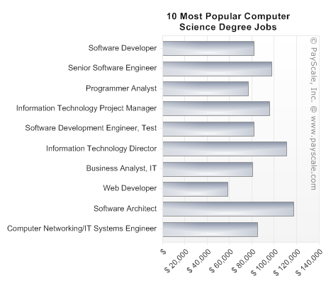
IT Professions
http://classesandcareers.com/online-programs/information_technology

